Slide 1
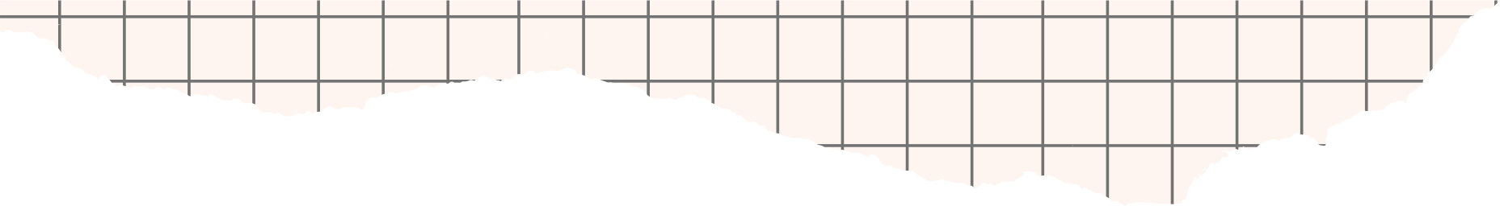



DYNAMIC TRAFFIC LIGHTS MANAGEMENT SYSTEM USING SUMO

Slide 2



INDEX
Introduction
Results
Objectives
Conclusion
Project overview
Summary
Methodology
References

Slide 3



INTRODUCTION
Traffic congestion wastes time and energy for urban commuters due to inefficient, rule-based traffic lights.
Our goal is to develop a dynamic traffic light management system using SUMO simulation and reinforcement learning to minimize vehicle wait times.
The model operates with minimal data - only vehicle counts at intersections. It adapts in real-time, optimizing signals based on traffic flows.
The system paves the way for more intelligent, responsive urban transportation infrastructure, enhancing quality of life.

Slide 4

OBJECTIVES
Develop realistic urban traffic simulation in SUMO
Implement reinforcement learning model to optimize signals
Reduce waiting times at signals
Pre-process data for model input
Train and tune model for optimal signal control
Evaluate model performance on waiting times, traffic flow
Compare to manual traffic management
Assess scalability to larger networks
Document for real-world deployment
Provide recommendations for future enhancements

Slide 5
PROJECT OVERVIEW
This project develops a Dynamic Traffic Light Management System (DTLMS) using SUMO and reinforcement learning to optimize traffic signals.
A virtual urban road network is established in SUMO to develop and test DTLMS.
The intelligent algorithm adapts signal timings to reduce congestion and travel delays.
By integrating simulation, real-time data, and innovative signal control strategies, this project contributes to a more efficient traffic management system for modern urban transportation.

Slide 6

METHODOLOGY
Simulate urban grid in SUMO with 4 traffic light nodes
Model makes green light decisions for each node and sets minimum green time (e.g. 30 secs). Goal is minimizing vehicle wait time at signals
Wait time calculated by cars present x seconds. Model selects green side based on lowest wait time
Fixed vehicle routes for consistent training events
Input is vehicle counts at each intersection side
Output is green light side for each node
Multiple SUMO simulations on different maps to train model
Reinforcement learning optimizes signals to reduce waits

Slide 7
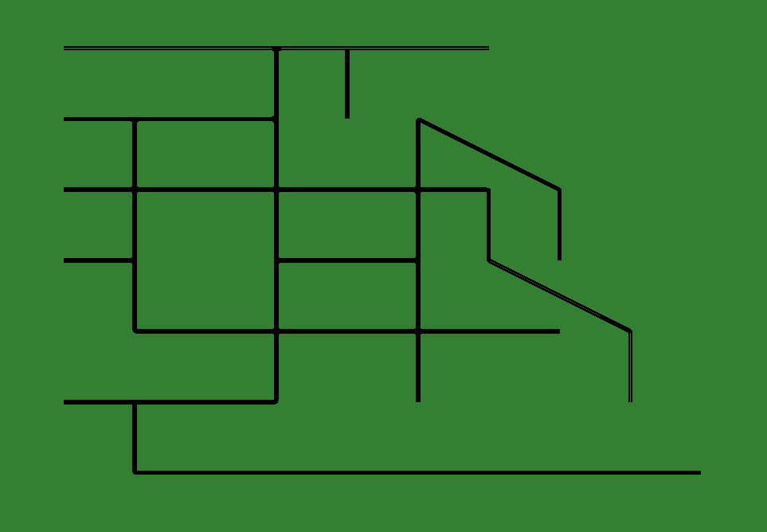
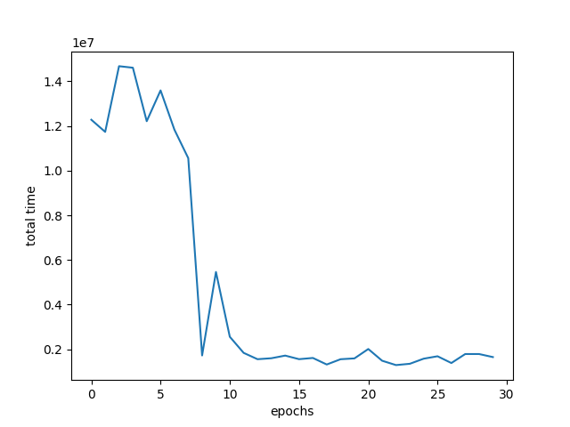

RESULTS
Map1
Epoch vs time for Map1

Slide 8
CONCLUSIONS
The project presents an innovative approach to improve traffic light management using reinforcement learning and SUMO simulation
Aims to optimize urban traffic flow, reduce waiting times and congestion
Addresses limitations of manual traffic light management
Leverages real-time vehicle count data for intelligent signal control
Reinforcement learning model adapts to traffic conditions through rewards
Demonstrates potential of AI and simulation to enhance urban transportation
Brings us closer to smarter, more efficient traffic management
Holds promise for improving quality of life if implemented in cities

Slide 9

Summary
The project demonstrates a promising dynamic traffic light management system using reinforcement learning and Simulation of Urban Mobility (SUMO) to minimize congestion. Further development could lead to real-world implementation, significantly enhancing urban transportation infrastructure.

Slide 10

REFERENCES
Medium blog: https://becominghuman.ai/reinforcement-learning-sumo-and-complex-urban-traffic-management-82e3b8cdd110#:~:text=In%20order%20to%20approach%20reinforcement,every%20vehicle%20in%20the%20simulation
Medium blog: https://medium.com/@thelifeproject/using-simulation-of-urban-mobility-for-reinforcement-learning-8b73b894d072
Multi-agent-reinforcement learning for integrated and networked traffic controller: https://patents.google.com/patent/CA2859049A1/en?oq=reinforcement+learning+for+traffic+lights+management
Research journal: https://researchonline.ljmu.ac.uk/id/eprint/9338/1/PID5384569.pdf
Blog: https://maxschrader.io/reinforcement-learning-and-sumo

Slide 11



THANK YOU!

